Slide 1


Data Structure
Course Code : ENCS205
Dr Swati Gupta
Associate Professor, School of Engineering & Technology
K.R. Mangalam University
Unit 4 :Trees and Graphs
Notes:
New Courses replaced with New Programmes

Slide 2

Key Learning Outcomes
Understand the hierarchical structure of trees and how they differ from other data structures like arrays, linked lists.
Apply tree-based algorithms and operations, such as insertion, deletion, searching, and traversal, to solve problems
Evaluating the efficiency of tree operations and understand how tree structure impacts the time complexity of these operations.
Notes:
New Courses replaced with New Programmes

Slide 3
BASIC INTRODUCTION OF TREES
Session 46
Applications of Tree in Real World
Basic Introduction of Trees
Basic Terminology used in Trees
Classification of Trees on the basis of Number of Children
Test Your Knowledege
Notes:
New Courses replaced with New Programmes

Slide 4

Applications of Trees in Real World
To store hierarchy of people
[Source :https://www.masaischool.com/blog/applications-of-tree/]
Notes:
New Courses replaced with New Programmes

Slide 5
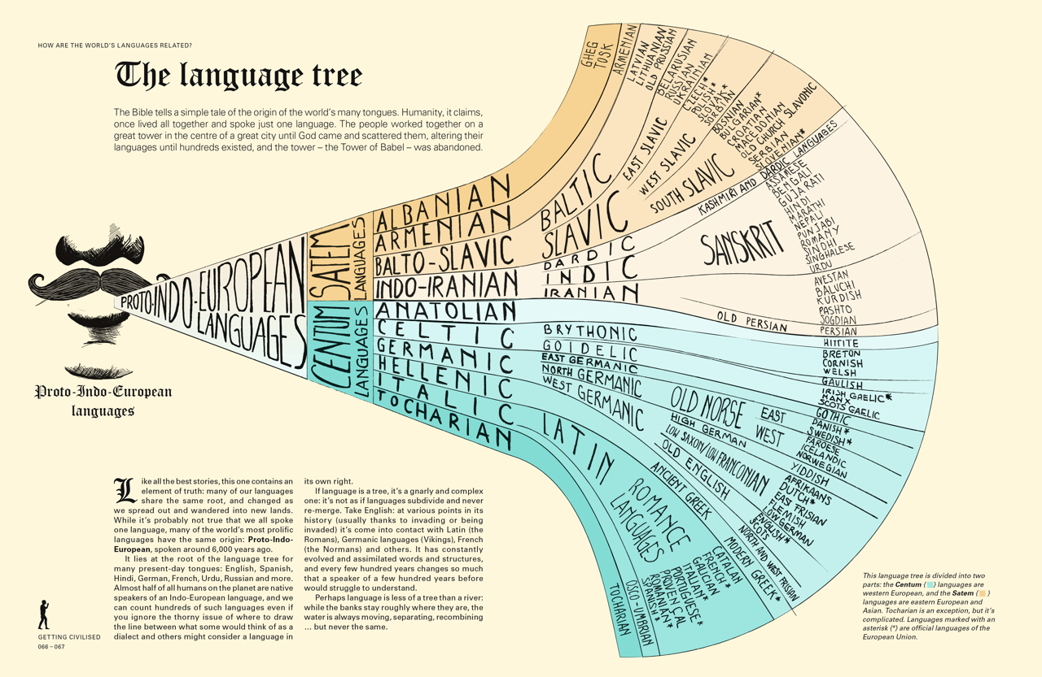
Applications of Trees in Real World
To capture the evolution of languages
Source :https://www.masaischool.com/blog/applications-of-tree/]
Notes:
New Courses replaced with New Programmes

Slide 6

Applications of Trees in Real World
To organize file-systems
Source :https://www.masaischool.com/blog/applications-of-tree/]
Notes:
New Courses replaced with New Programmes

Slide 7
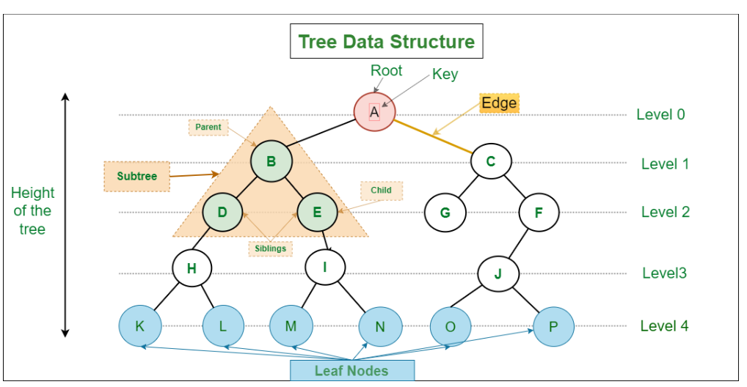
Basic Introduction of Tress
Tree is a hierarchical structure that is used to represent and organize data in a way that is easy to navigate and search.
It is a collection of nodes that are connected by edges and has a hierarchical relationship between the nodes.
Tree Data Structure
[Source :https://www.geeksforgeeks]
Notes:
New Courses replaced with New Programmes

Slide 8
Properties of a Tree
Property 1 :The numbers of nodes in a tree must be a finite and
nonempty set.
Property 2 : There must exist a path to every node of a tree i.e.,
every node must be connected to some other
node.
Property 3 : There must not be any cycles in the tree. It means
that the number of edges is one less than the
number of nodes.
Please Refer :
https://www.youtube.com/watch?v=tORLeHHtazM.
Notes:
New Courses replaced with New Programmes

Slide 9
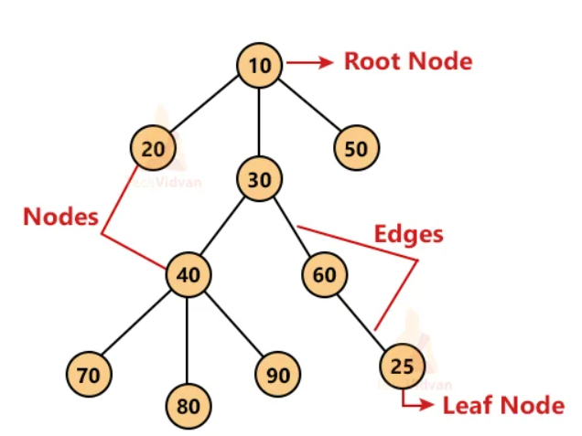
Basic Terminology in Tree Data Structure
Root-
The first node from where the tree originates is called as a root node.
In any tree, there must be only one root node.
Edge-
The connecting link between any two nodes
is called as an edge.
In a tree with n number of nodes,
there are exactly (n-1) number of edges.
Notes:
New Courses replaced with New Programmes

Slide 10
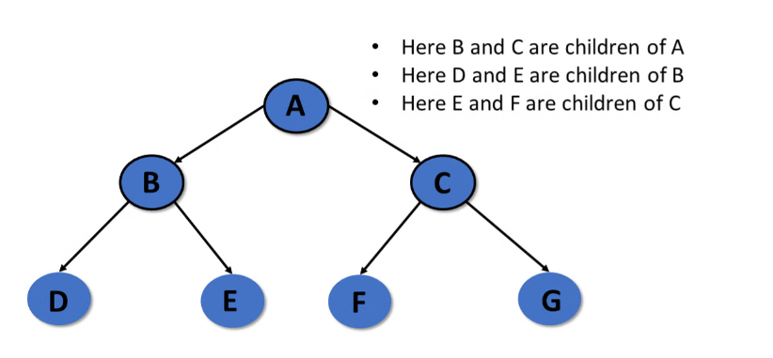
Basic Terminology in Tree Data Structure
Parent-
The node which has a branch from
it to any other node is called as a parent node.
Parent node can have any number of
child nodes.
Child-
The node which is a descendant of some
node is called as a child node.
All the nodes except root node are
child nodes.
Notes:
New Courses replaced with New Programmes

Slide 11
Basic Terminology in Tree Data Structure
Internal Node-
The node which has at least one child is called as an internal node.
Internal nodes are also called as non-terminal nodes.
Every non-leaf node is an internal node.
Leaf Node
The node which does not have any child is called as a leaf node.
Leaf nodes are also called as external nodes or terminal nodes.
Degree-
Degree of a node is the total number of children of that node it is the highest degree of a node.
Notes:
New Courses replaced with New Programmes

Slide 12
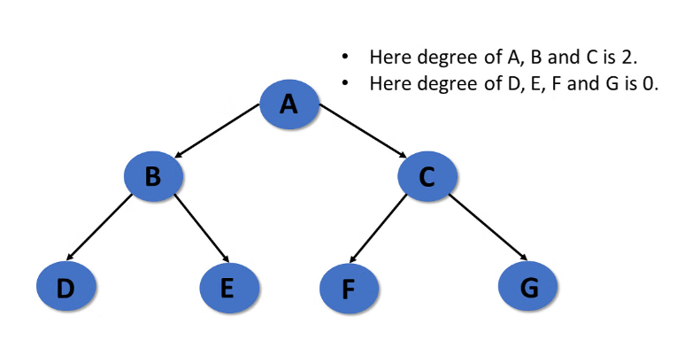
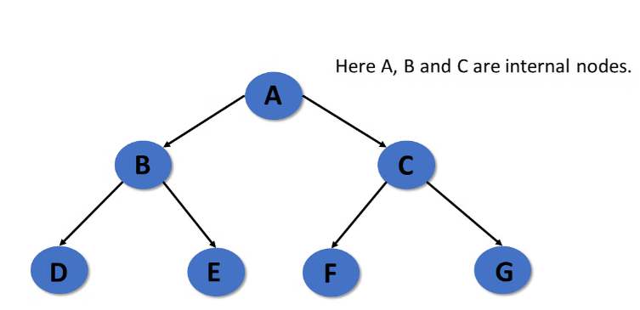
Basic Terminology in Tree Data Structure
Notes:
New Courses replaced with New Programmes

Slide 13
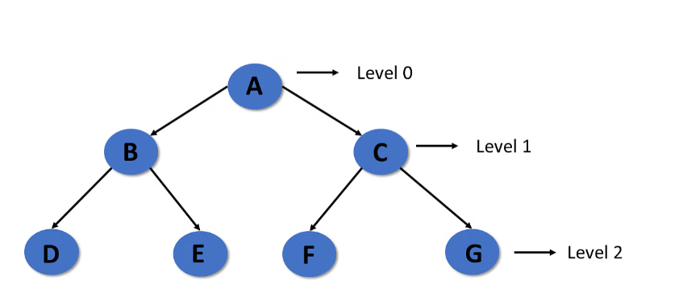
Basic Terminology in Tree Data Structure
Level-
In a tree, each step from top to bottom is called as level of a tree.
The level count starts with 0 and increments by 1 at each level or step.
Notes:
New Courses replaced with New Programmes

Slide 14
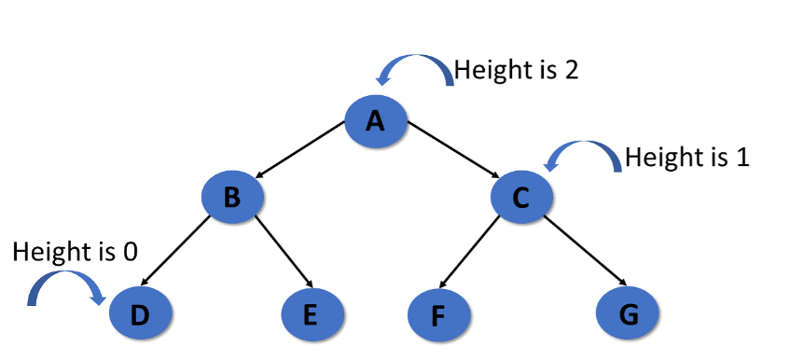
Basic Terminology in Tree Data Structure
Height-
Total number of edges that lies on the longest path from any leaf node to a particular node is called as height of that node.
Height of a tree is the height of root node.
Height of all leaf nodes = 0
Notes:
New Courses replaced with New Programmes

Slide 15
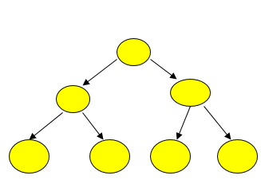
Max Number of Nodes at any level l
nodes = 1 height = 0
nodes = 3 height = 1
nodes = 7 height = 2
nodes = 2h+1- 1 height = h
Since L = 2h
and since the number of internal nodes = 2h-1 the
total number of nodes n = 2h+ 2h-1 = 2(2h) – 1 = 2h+1- 1.
Notes:
New Courses replaced with New Programmes

Slide 16

Declaring a Node of a Tree in Python
A tree node includes the following parts:-
Data
Pointer to the left child
Pointer to the right child
class TreeNode:
def __init__(self, value):
self.value = value
self.left = None
Please refer : https://www.pythonforbeginners.com/data-structures/tree-data-structure-in-python.
self.right = None
Notes:
New Courses replaced with New Programmes

Slide 17
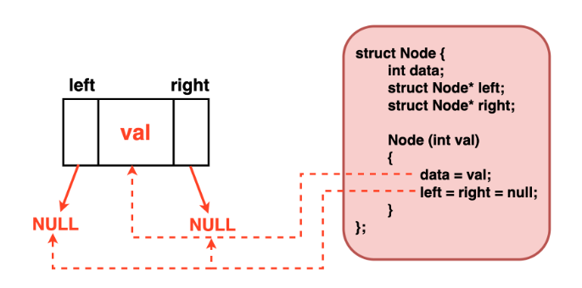
Declaring a Node of a Tree using C++
.
Notes:
New Courses replaced with New Programmes

Slide 18
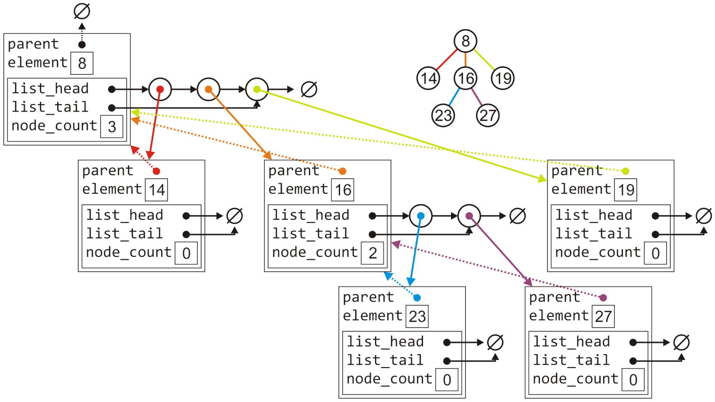
Implementation
The tree with six nodes would be stored as follows:

Slide 19
Implementing Binary Tree
A structure to create node
A constructor to the struct node
that inserts value in the data variable.
struct Node {
int data;
struct Node* left;
struct Node* right;
Node(int value)
{
data = value;
left = NULL;//Left child is initialized to NULL
right = NULL;//Right child is initialized to NULL
}
};

Slide 20
Implementing Binary Tree
A function to print the tree
Main Function
void Printtree(struct Node *root)
{//Check if tree is empty
if(root == NULL)
return;
//We will use inorder traversal to print the tree
Printtree(root -> left);
cout << root -> data << " ";
Printtree(root -> right);
}
int main()
{
// creating root
struct Node* root = new Node(1);
root->left = new Node(2);//inserting 2 to the left of root
root->right = new Node(3);//Inserting 3 to the right of root
Printtree(root);
return 0;
}

Slide 21
Test Your Knowledge
Q1 What is the topmost node of a tree called?
A) Parent node
B) Leaf node
C) Root node
D) Sibling node
Q2 Which of the following terms describes nodes that share the same parent node?
A) Leaf nodes
B) Sibling nodes
C) Ancestor nodes
D) Child nodes
Q3 What term is used to describe a node with no children in a tree?
A) Parent node
B) Leaf node
C) Root node
D) Sibling node
Notes:
New Courses replaced with New Programmes

Slide 22
Test Your Knowledge
Q4 Which of the following represents the number of edges on the path from the root to a node in a tree?
A) Height
B) Depth
C) Width
D) Length
Q5 What is a node in a tree data structure?
A) The root of the tree
B) A leaf in the tree
C) An element in the tree that contains data and links to its children
D) None of the above
Notes:
New Courses replaced with New Programmes

Slide 23
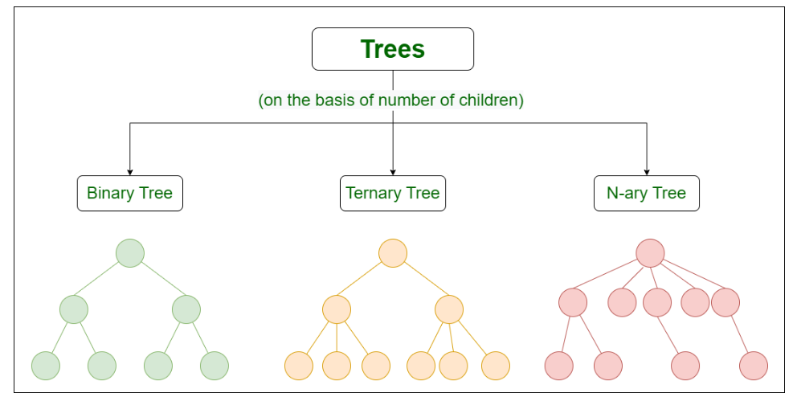
Types of Trees in Data Structure
Notes:
New Courses replaced with New Programmes

Slide 24
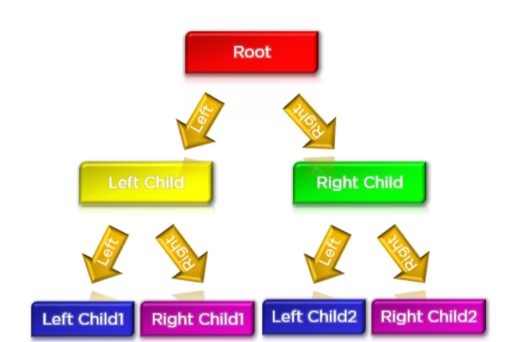
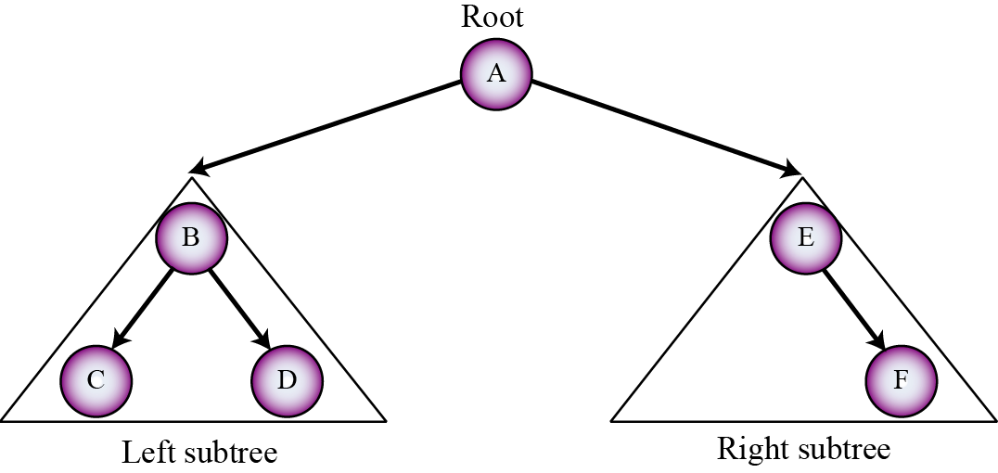
Binary Tree
A binary Tree is defined as a Tree data structure with at most 2 children.
Since each element in a binary tree can have only 2 children, we typically name them the left and right child.
Notes:
New Courses replaced with New Programmes

Slide 25
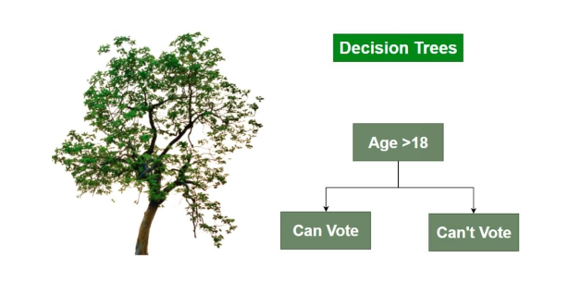
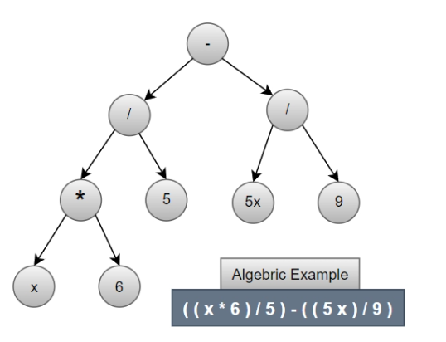
Real Life Use Cases of Binary Tree
Decision Trees:
2. Expression Trees
Notes:
New Courses replaced with New Programmes

Slide 26
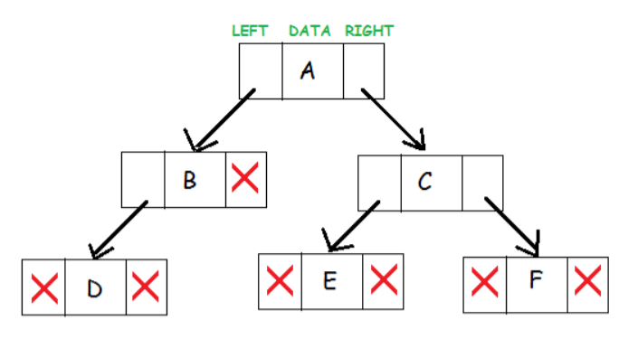
Binary Tree Components
Binary tree node has these three components associated with it.
Data element
Pointer to left subtree
Pointer to right subtree
Notes:
New Courses replaced with New Programmes

Slide 27
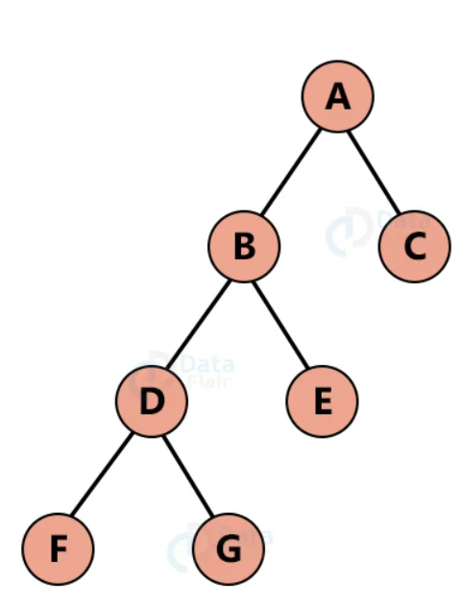
Types of Binary Tree
Full Binary Tree
Here, each node in a tree has either 0 or exactly 2 child nodes. A full Binary tree is also known as a proper binary tree.
Notes:
New Courses replaced with New Programmes

Slide 28
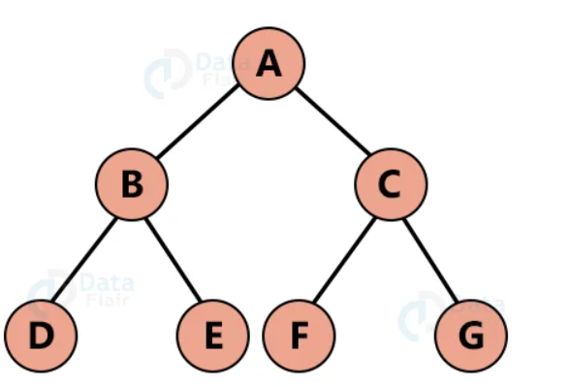
Types of Binary Tree
Perfect binary tree
Here, each parent node has exactly 2 child nodes and all child nodes are at the same level.
Notes:
New Courses replaced with New Programmes

Slide 29
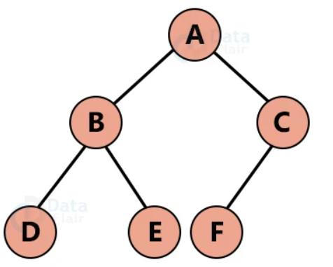
Types of Binary Tree
Complete binary tree
A complete binary tree is a version of a full binary tree with 2 major differences;
1. Each level must be filled
2. All leaf elements must lean towards left
3. t is not compulsory for a left child node to have a right sibling node. A complete Binary tree need not necessarily be a full binary tree
Notes:
New Courses replaced with New Programmes

Slide 30
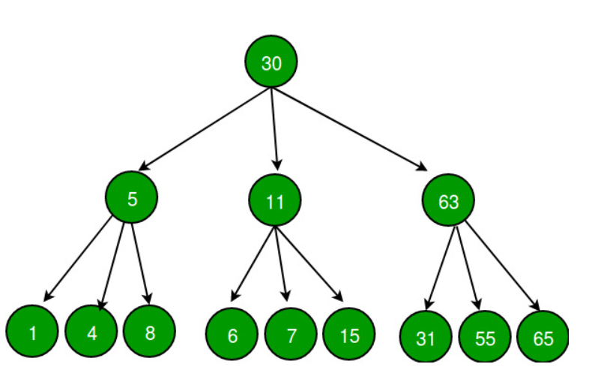
Ternary Tree
A Ternary Tree is a tree data structure in which each node has at most three child nodes, usually distinguished as “left”, “mid” and “right”.
Notes:
New Courses replaced with New Programmes

Slide 31
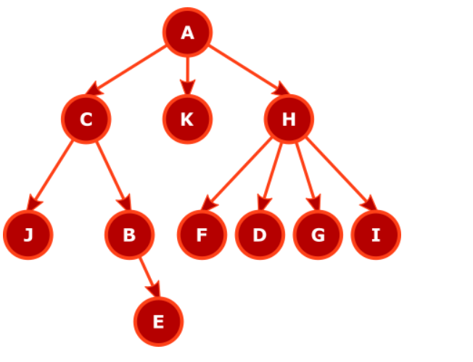
N-ary Tree
The N-ary Tree allows a node to have up to N children
Notes:
New Courses replaced with New Programmes

Slide 32
Use case of N-ary Tree
Problem: Representing and managing hierarchical data in an organization with multiple levels and branching.
Solution:
Organization Structure: Use an N-ary tree to represent the organizational hierarchy of a company.
Nodes: Each node represents an employee, with additional attributes such as name, position, and department.
Children: The children of each node represent the direct reports or subordinates of an employee.
Operations:
Adding Employees:
Accessing Employees:
Notes:
New Courses replaced with New Programmes

Slide 33
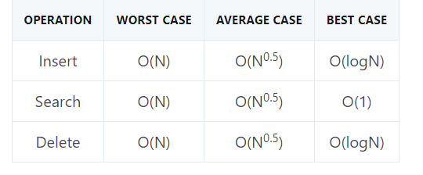
Complexity Analysis of Binary Tree
Time Complexity of different operations in Binary Tree:
Notes:
New Courses replaced with New Programmes

Slide 34
Test Your Knowledge
Q1 What does the following function do for a given binary tree?
int fun(struct node *root)
{
if (root == NULL)
return 0;
if (root->left == NULL && root->right == NULL)
return 0;
return 1 + fun(root->left) + fun(root->right);
}
(A) Counts leaf nodes (B) Counts internal nodes (C) Returns height where height is defined as number of edges on the path from root to deepest node (D) Return diameter where diameter is number of edges on the longest path between any two nodes.
Answer (B)
Notes:
New Courses replaced with New Programmes

Slide 35
Test Your Knowledge
Q2 Which of the following is NOT a valid property of a binary tree?
(A) A binary tree with n nodes has n−1 edges.
(B) In a binary tree, the maximum number of nodes at any level k is 2k.
(C) In a binary tree, the maximum depth is equal to the number of nodes minus one.
(D) In a binary tree, the maximum number of nodes at depth d is 2d
Answer: (C)
Q 3 Every very node in a complete n-ary tree has either 0 or n children. If x denotes the number of internal nodes, then the number of leaves in a complete n-ary tree is given by
a) x(n-1)+1
b) xn-1
c) xn+1
d) x(n+1) Ans. a) x(n-1)+1
Notes:
New Courses replaced with New Programmes

Slide 36
Test Your Knowledge
Q4 Which of the statements below is false?
a) (n-1) edges exist in a tree with n nodes.
b) The postorder and preorder traversal results may create a labeled rooted binary tree uniquely.
c) There are (n+1) leaves in a complete binary tree with n internal nodes.
d) In a binary tree of height h, the maximum number of nodes is/are (2(h+1) -1).
Ans. a) and d)
Q5 If the tree is not a complete binary tree then what changes can be made for easy access of children of a node in the array? a) every node stores data saying which of its children exist in the array b) no need of any changes continue with 2w and 2w+1, if node is at i c) keep a separate table telling children of a node d) use another array parallel to the array with tree
Answer: a
Notes:
New Courses replaced with New Programmes

Slide 37
Test Your Knowledge
Q6 Suppose a binary tree is constructed with n nodes, such that each node has exactly either zero or two children. The maximum height of the tree will be? a) (n+1)/2 b) (n-1)/2 c) n/2 -1 d) (n+1)/2 -1 Answer: (B)
Q 7 Which of the following statement about binary tree is CORRECT? a) Every binary tree is either complete or full b) Every complete binary tree is also a full binary tree c) Every full binary tree is also a complete binary tree d) A binary tree cannot be both complete and full Ans. (C)
Notes:
New Courses replaced with New Programmes

Slide 38
REVIEW
Tree is a collection of nodes that are connected by edges and has a hierarchical relationship between the nodes
A tree node includes the following parts:-
Data
Pointer to the left child
Pointer to the right child
Notes:
New Courses replaced with New Programmes

Slide 39
References
https://www.youtube.com/watch?v=oSWTXtMglKE
https://www.upgrad.com/blog/5-types-of-binary-tree/
https://www.javatpoint.com/tree
https://www.geeksforgeeks.org/tree-data-structure/
https://www.sanfoundry.com/1000-data-structure-questions-answers/
https://www.tutorialspoint.com/data_structures_algorithms/array_data_structure.htm
https://www.tutorialspoint.com/data_structures_algorithms/tree_data_structure.htm
https://www.simplilearn.com/tutorials/data-structure-tutorial/trees-in-data-structure
https://www.scaler.com/topics/data-structures/tree-data-structure/
Notes:
New Courses replaced with New Programmes

Slide 40
THANK YOU

